Slide 1
Social media strategy of the Dutch House of Representatives
An update

Slide 2
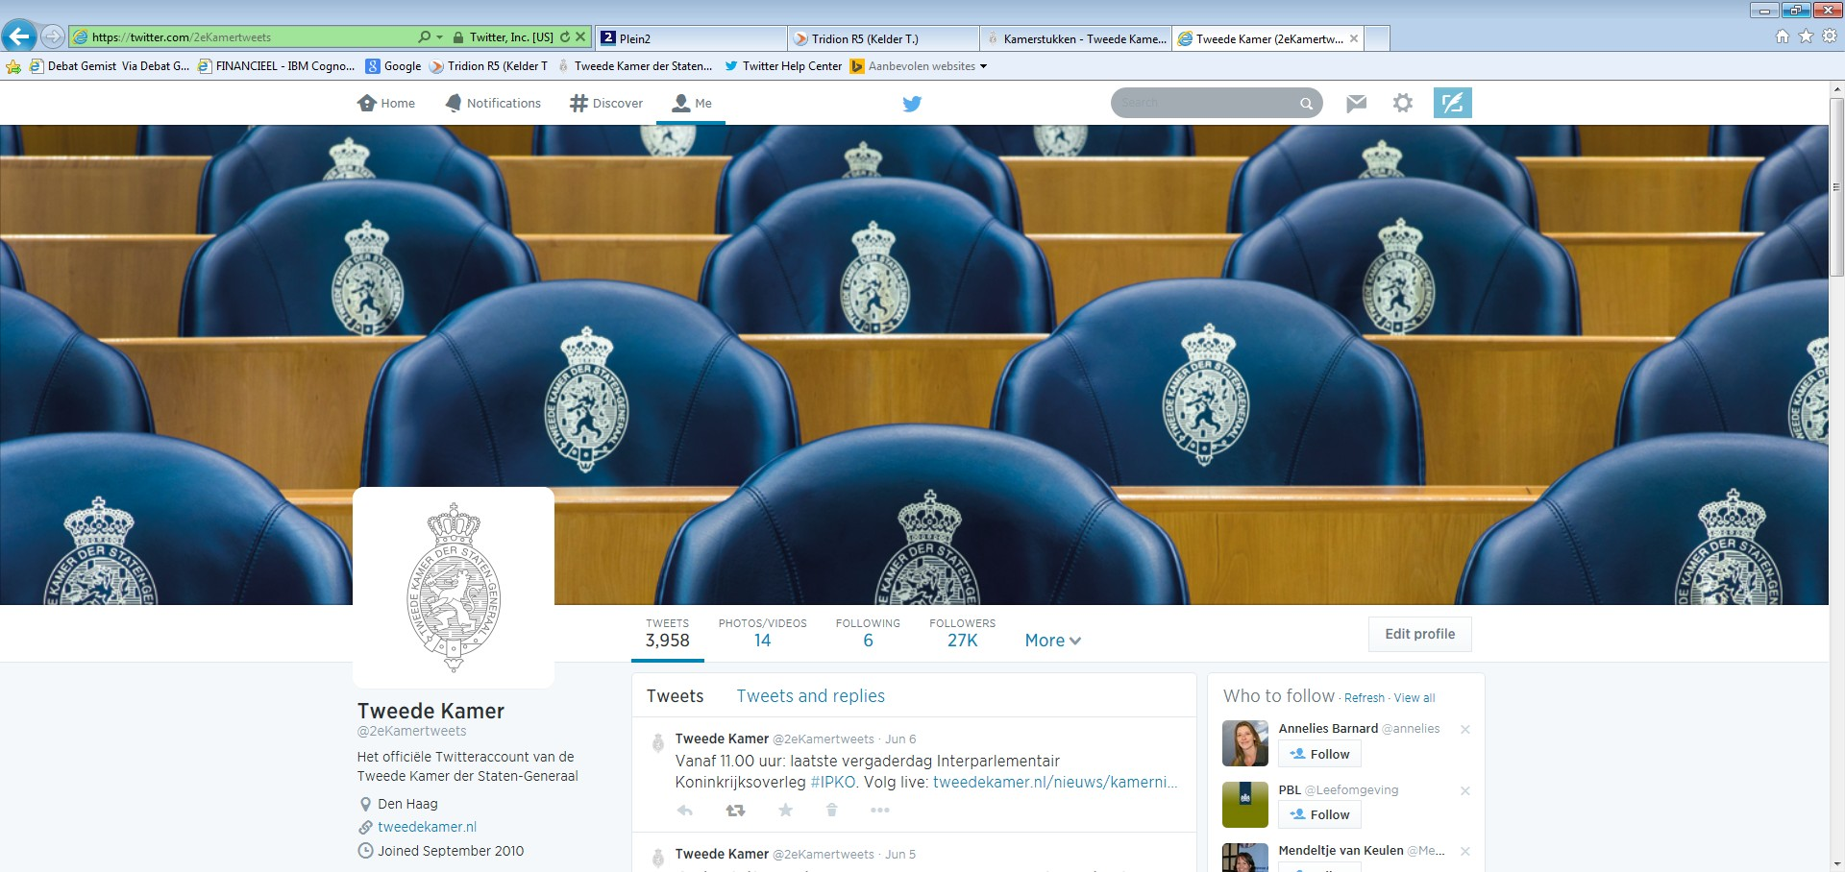

Slide 3
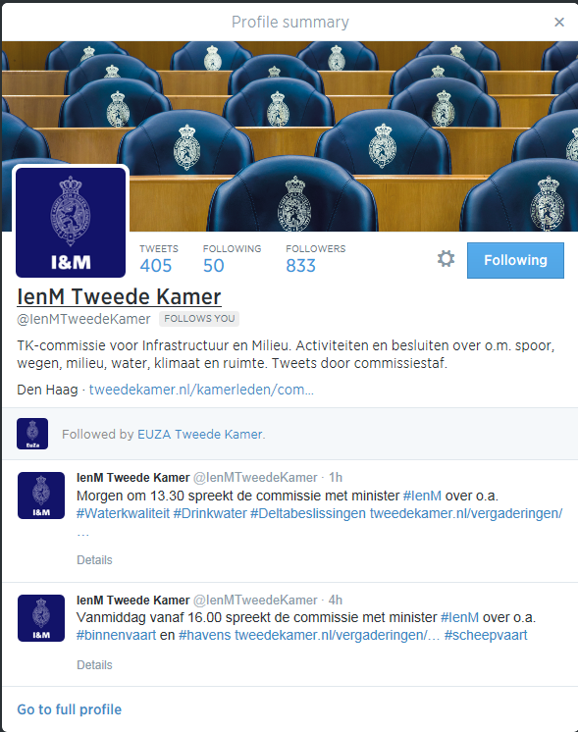
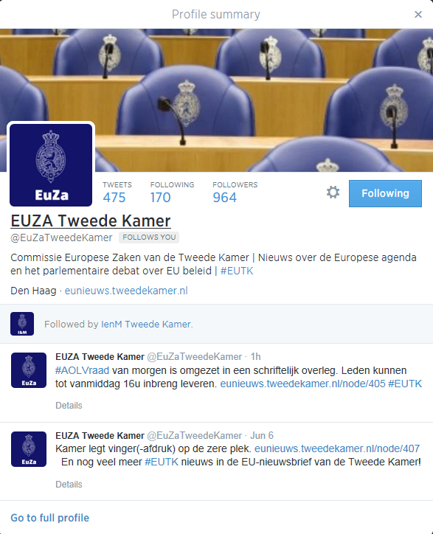

Slide 4
